Slide 1
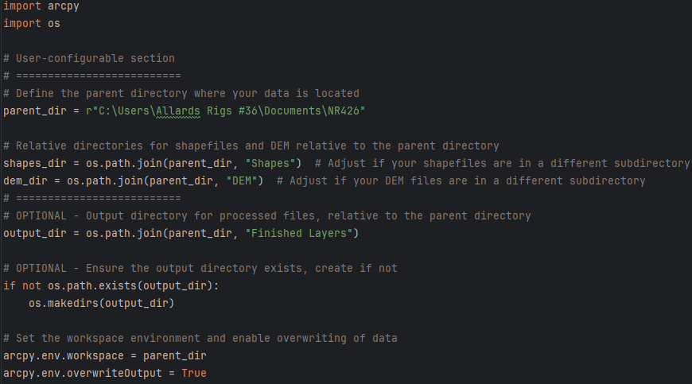
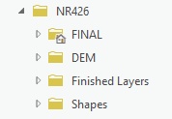
NR426 Final Project – Cam Caron
Define the base/parent directory for starting GIS data and results
Set up Arcpy environment and enable output data overwrite

Slide 2
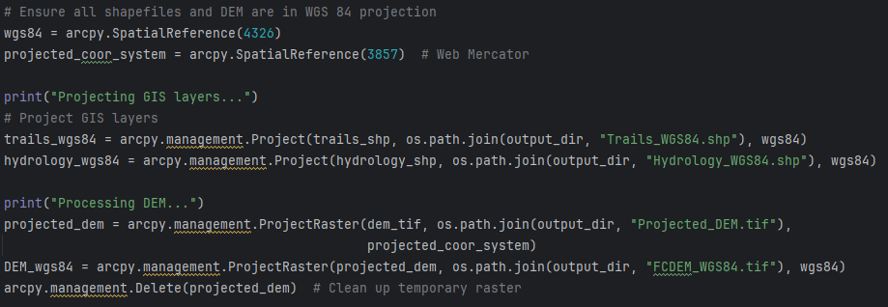
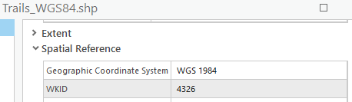
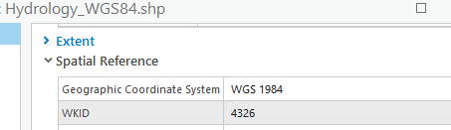
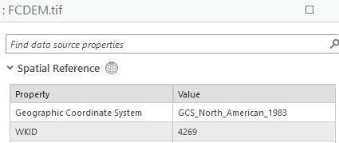
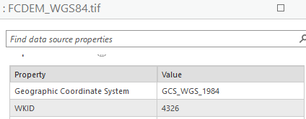
Project Trails and Hydrology shapefiles to WGS 84 spatial reference
Project a DEM file to a suitable projected coordinate system (Web Mercator) – reproject to WGS 84 for consistency

Slide 3
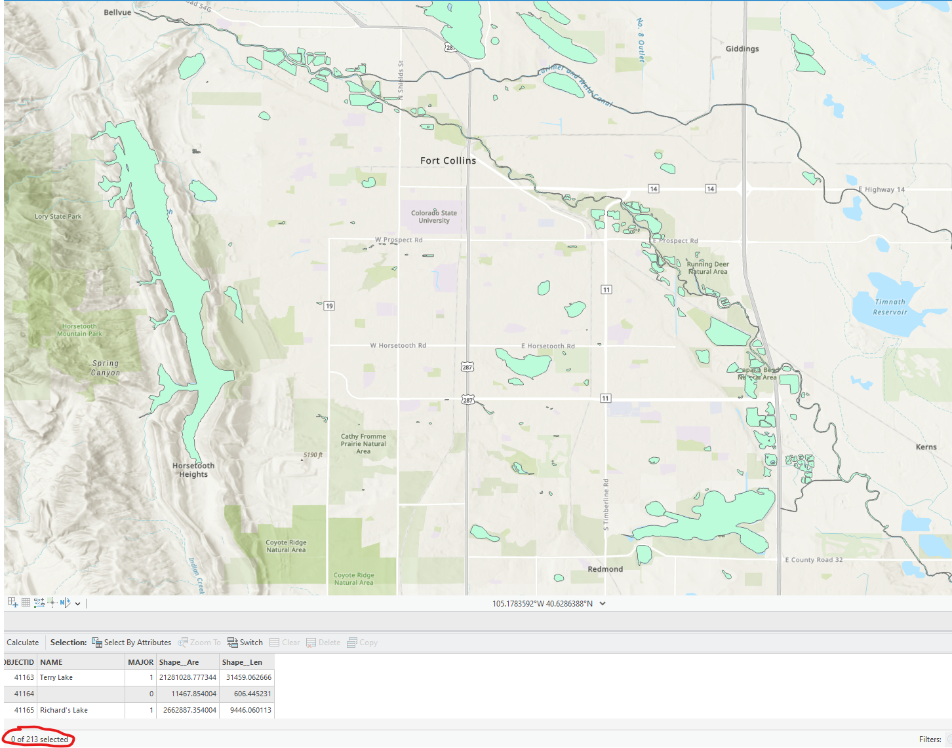
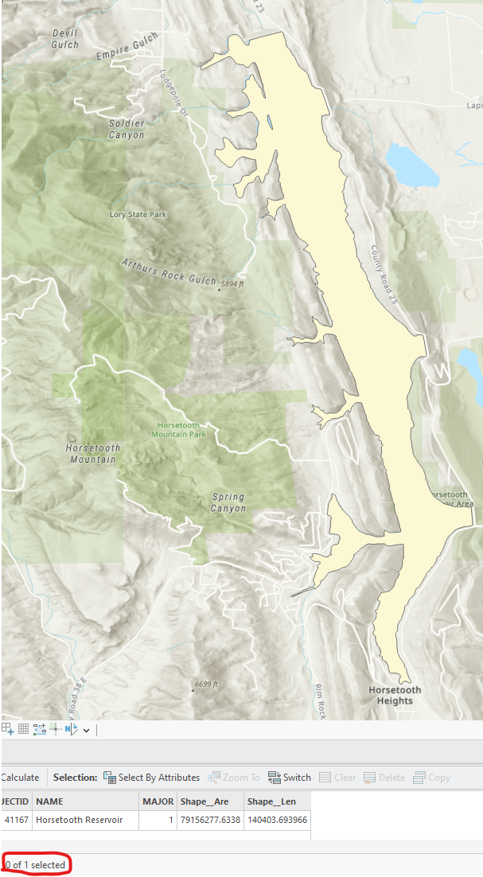
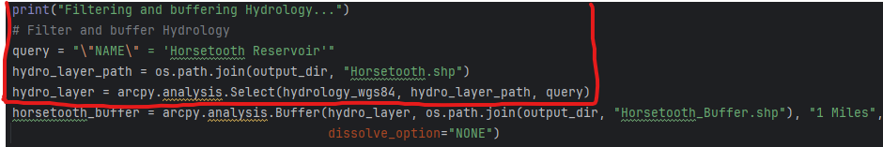
Filter the Hydrology layer to include only “Horsetooth Reservoir” and….

Slide 4
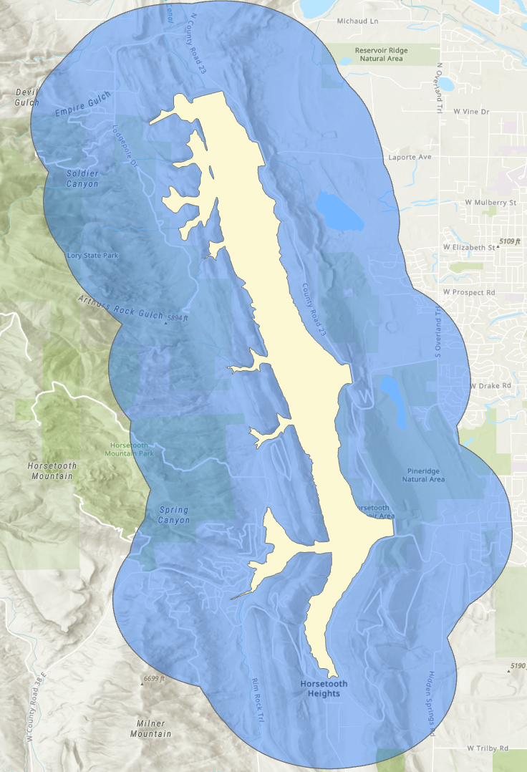
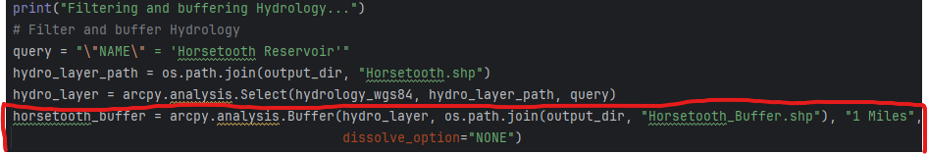
…. create a 1-mile buffer around it

Slide 5
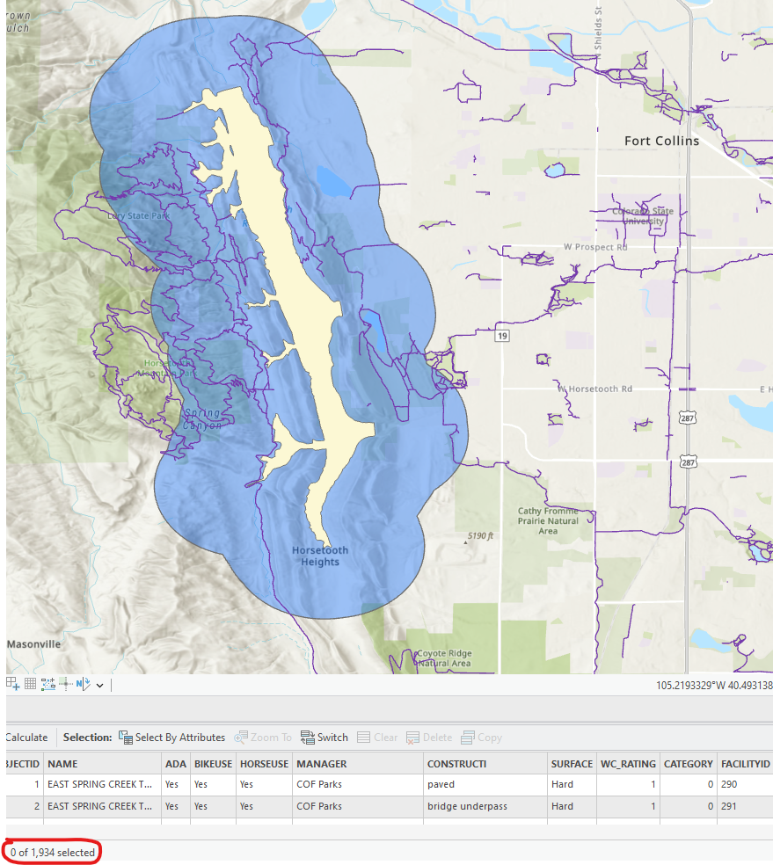
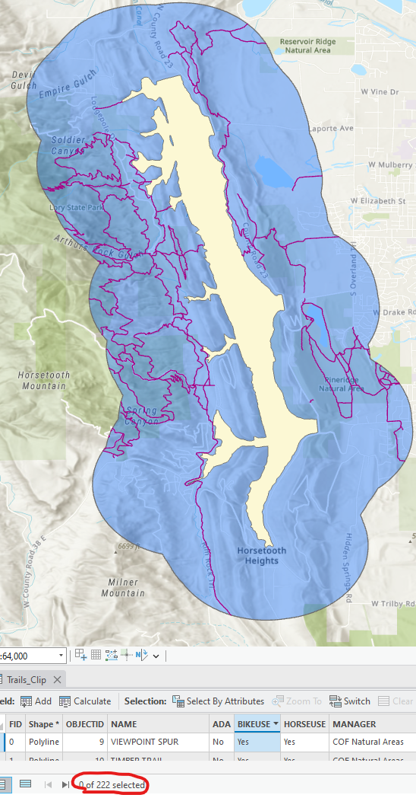
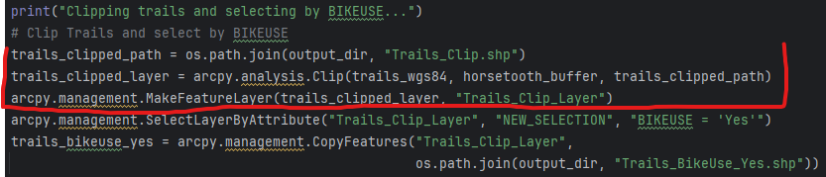
Clip the Trails layer by the Horsetooth Reservoir buffer to focus on relevant trails.

Slide 6
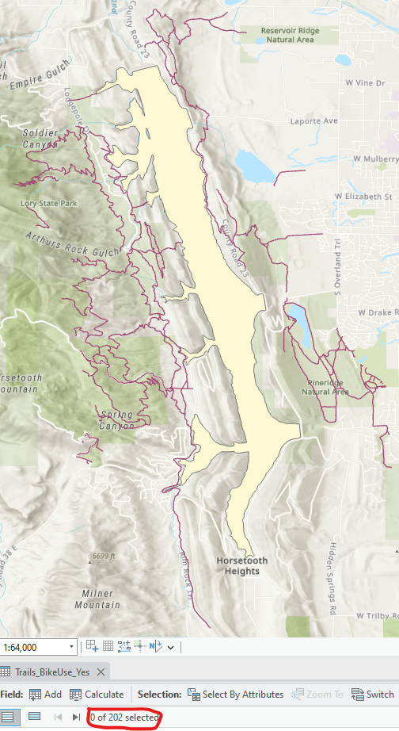
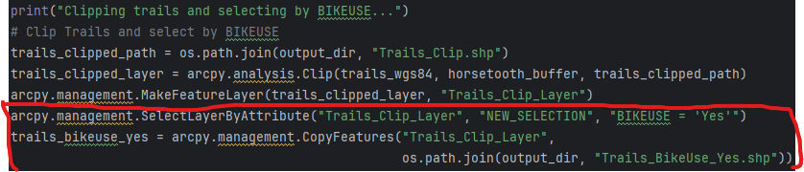
Then, select only those trails that are marked as bike-friendly

Slide 7
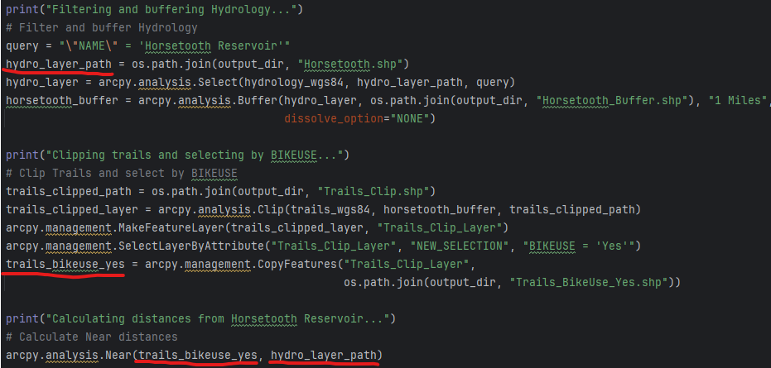
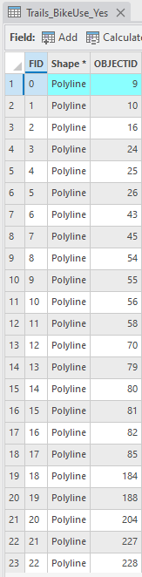
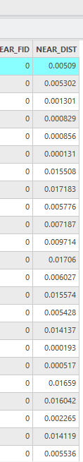
Calculate the distance of each bike-friendly trail from the Horsetooth Reservoir using the Near tool

Slide 8
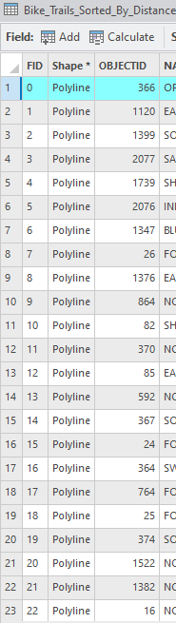
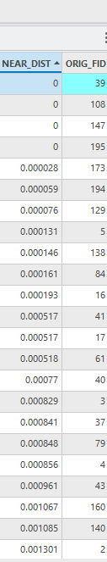
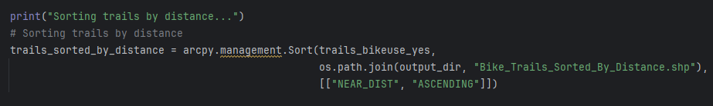
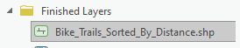
Sort bike-friendly trails by their proximity to Horsetooth Reservoir and output the sorted list into the “Finished Layers” directory

Slide 9
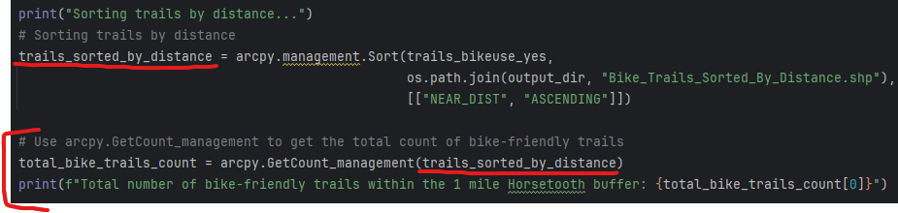
Use arcpy.GetCount_management to count the total number of bike-friendly trails within the specified buffer zone and display in the console

Slide 10
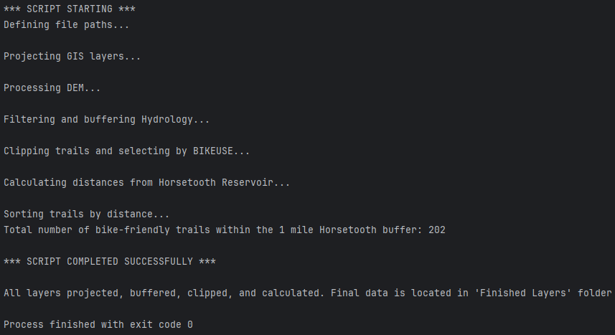
Final console readout

